Slide 1

ALLEN CREATIONS CORP.
Company Profile
APR. 2015

Slide 2

About Allen Creations and Allsun Group (ACC)
ACC was established in Aug.1988. We are a global manufacturing and export company specializing in advanced and high quality Telecom/ Datacom components, Connectors and Cable Assembly products.
ACC has developed and put to the market various advanced products in the Communication Networking field. To ensure competitiveness in its capacity to meet market demand, ACC has strategically increased its capital outlay and expanded the size of the plant.
ACC always maintains the highest quality control standards to consistently deliver reliable and robust products..

Slide 3


Organization Chart
CEO
Management Delegation
General Manager
Vice president
Manager
Dept.
QC
Dept.
Production
Dept.
Engineer
Dept.
Sales
Dept.
Sales
Dept.
Manager
Dept.
General Administration
Human Resource Management
Cashier
Accounting
Quality Control
Doc. Control Center
Quality inspection
A team
B team
C team
Machine Term
Plastic Term
Press Term
Technology
R & D
Customs Declaration
Warehouses Control
Materials Control
Purchase
Production Control
Sales
General Administration
Document Control
Accounting
Human Resource Management
Technology
Purchase
Quality Control
IQC
IPQC
OQC

Slide 4


Certificates
Certificate | File No.
 | E131820
 | E149026
ISO 9001:2008 | N° 2011/40079.1
ISO 14001:2004 | N° 2012/51808.1

Slide 5
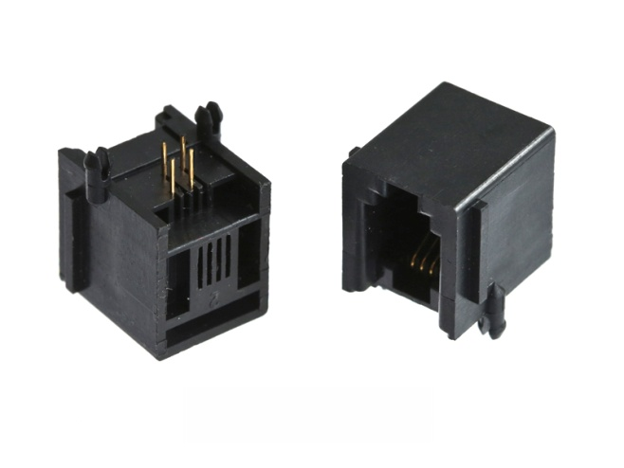
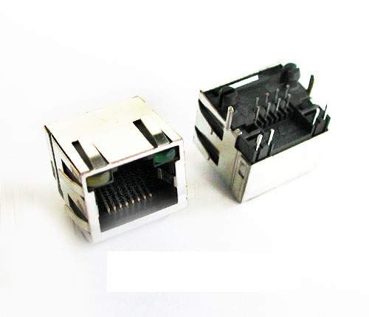
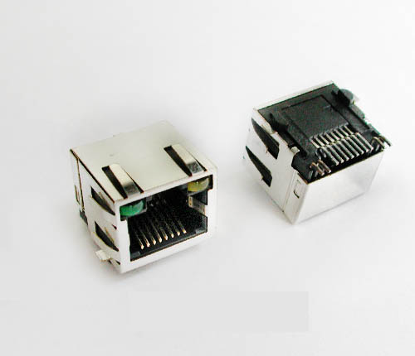
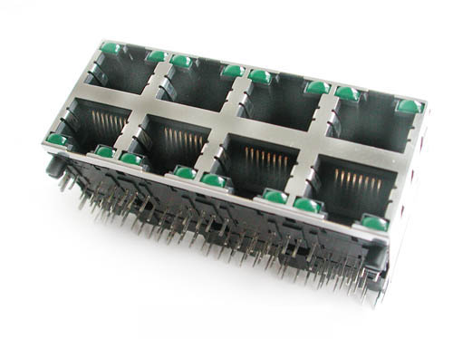
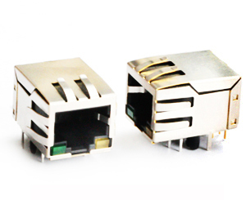


Major Products
RJ11 Jacks
RJ45 DIP Jacks
RJ45 SMT Jacks
Ganged Jacks
Jacks with Transformers

Slide 6
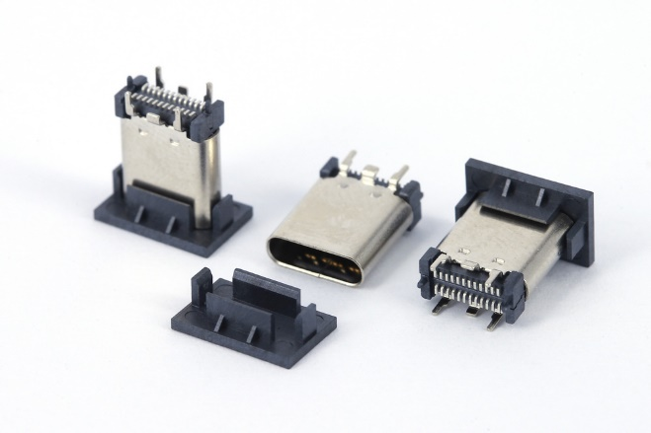
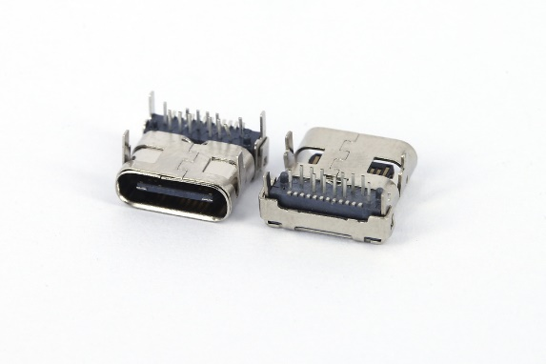
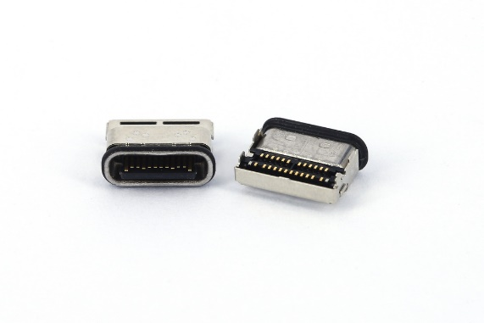
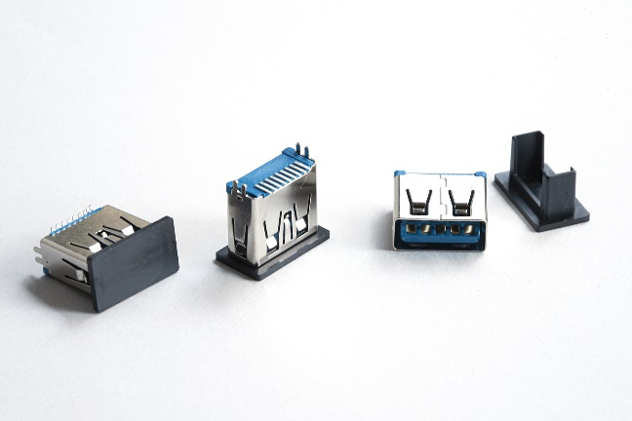
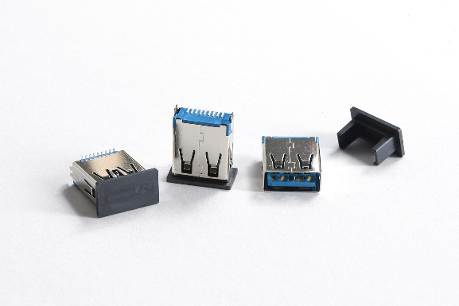
USB
FUCR-244X-04XX
FUCR-248K-10XX
LX-124018852112A
USB-3.0-A-TYPE-SMT-H11.55mm
USB-3.0-A-TYPE-SMT-H14.9mm

Slide 7
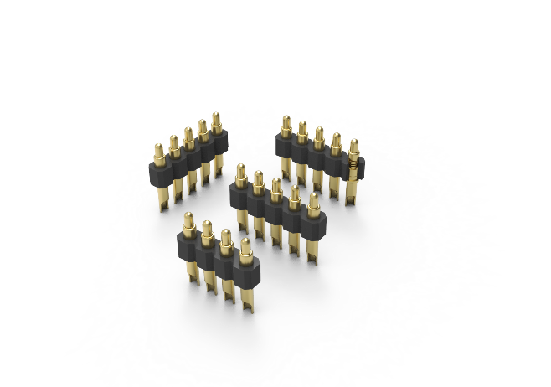
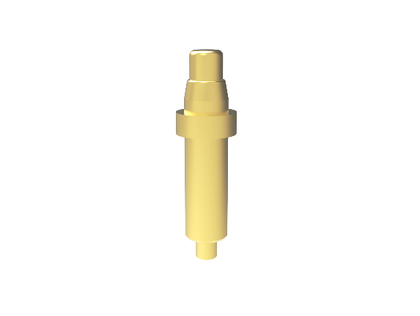
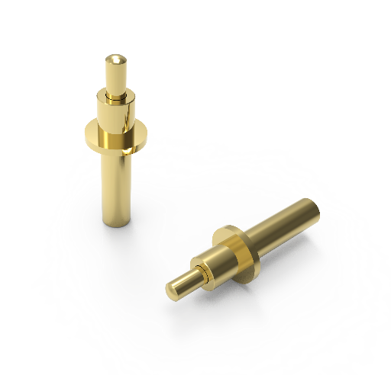
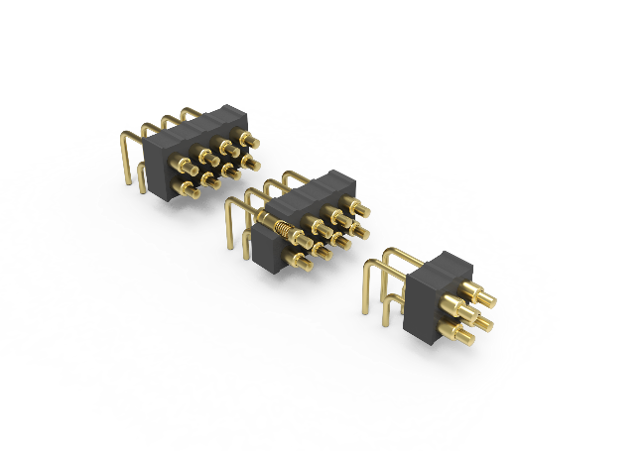
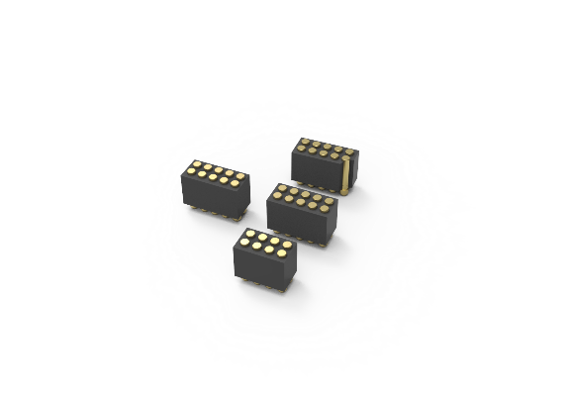
Probe Pin
a254solder-250dan001pitch-2.54
AJ13141
AJ77031
g200bend-s001_two.79pitch-2.54
r127smt-s01twopitch-1.27

Slide 8
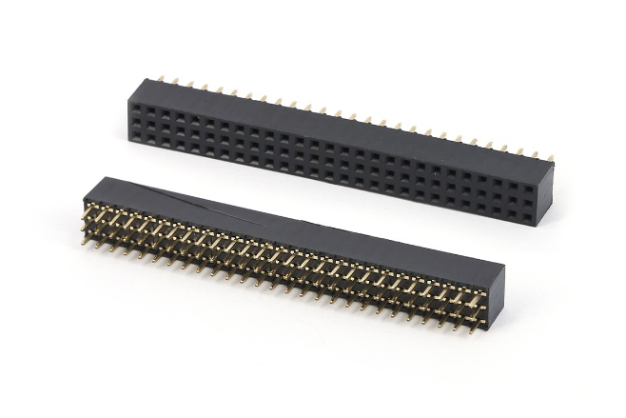
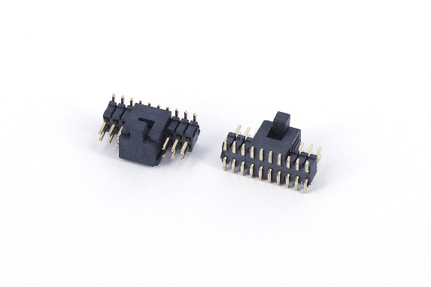
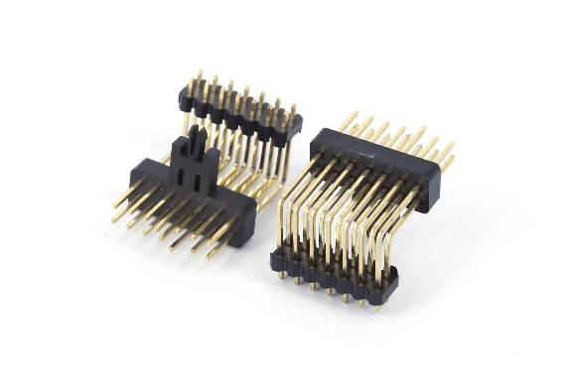
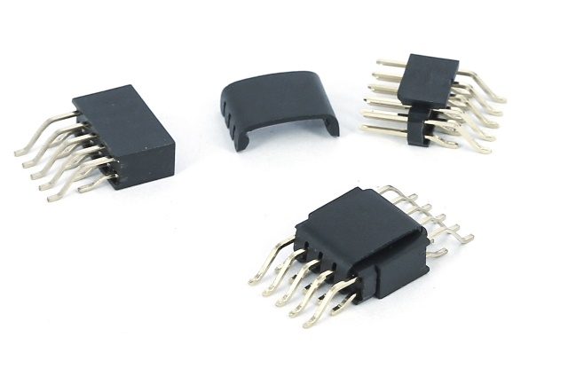
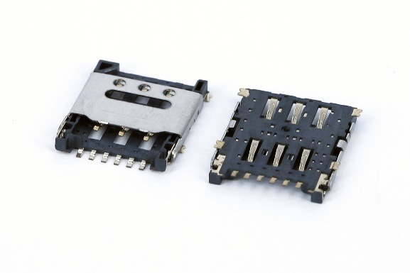
Pin Header
F200HV00AGN-327
P12TNS00AGN-210-RC
P254FR00AGN-207
Pin-headerLock-cap
SJP06-SM2871-L

Slide 9
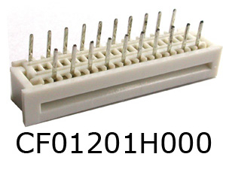
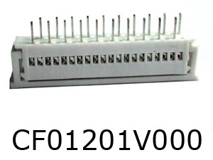
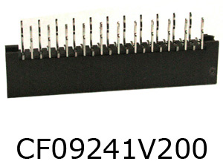
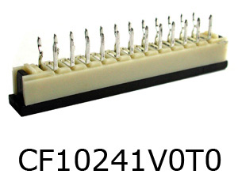
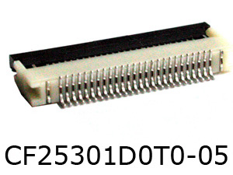
FPC Connector

Slide 10
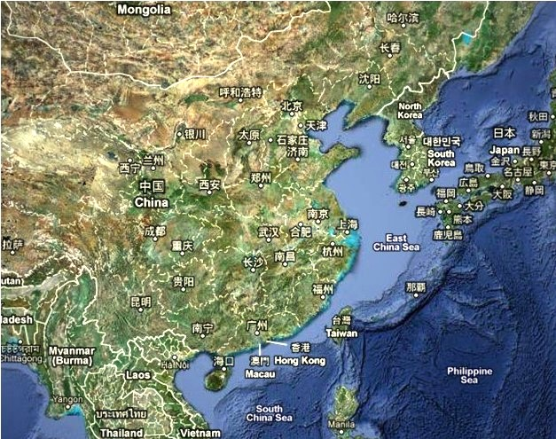
Manufacturing Facilities
Su-Zhou Factory
Factory
(Since 2006, Su-Zhou)
Dong-Guan Factory
China Office & Factory
(Since 19, Dong-Guan)
Shen-Zhen Factory
Factory
(Since 1992,Shen-Zhen)

Slide 11
Manufacturing Equipments
Dong-Guan Site
Horizontal injection | 13
Vertical injection | 5
Stamping | 10
Grinder | 2
Milling | 2
Drilling | 3
Pneumatic table stamping | 20
Handling table stamping | 50
Employee | 100
Shen-Zhen Site
Horizontal injection | 7
Vertical injection | 4
Pneumatic table stamping | 70
Handling table stamping | 120
Employee | 110
Su-Zhou Site
Pneumatic table stamping | 50
Handling table stamping | 30
Employee | 70

Slide 12
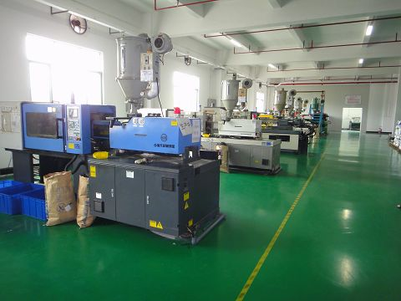
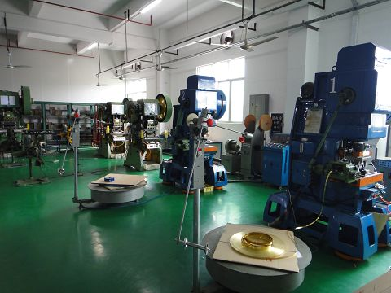
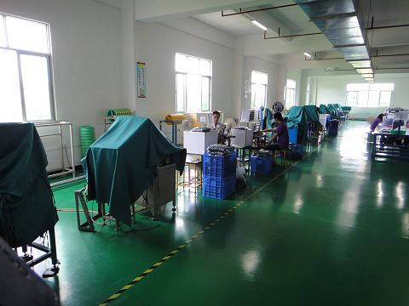
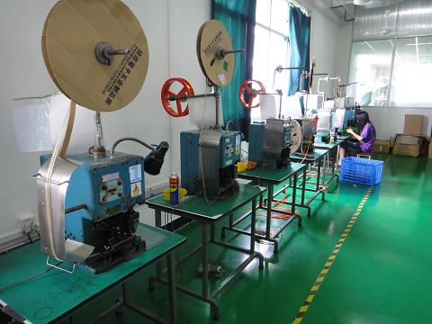
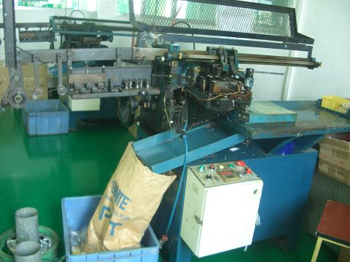
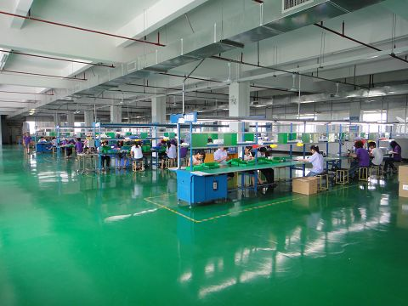
Production Line Overview

Slide 13
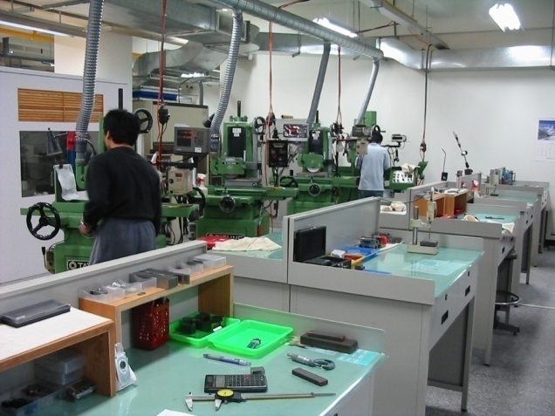
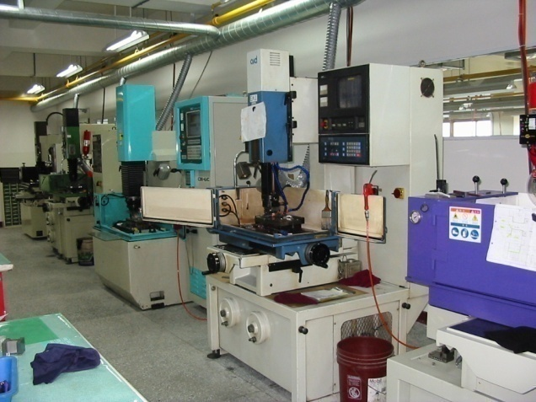
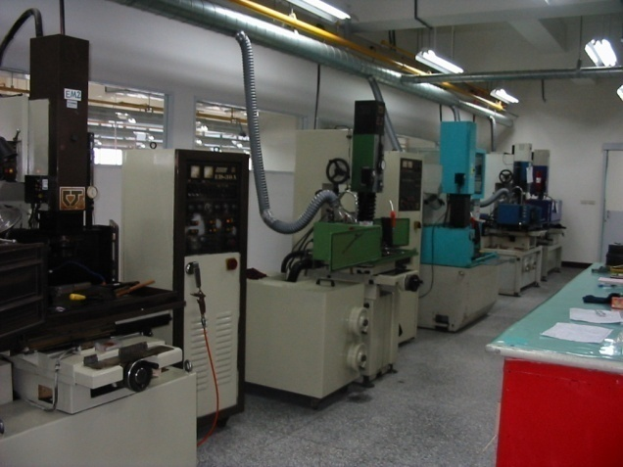
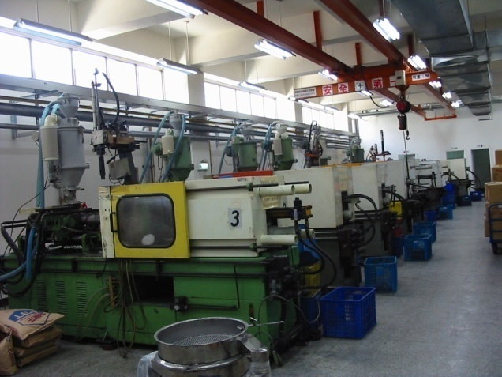
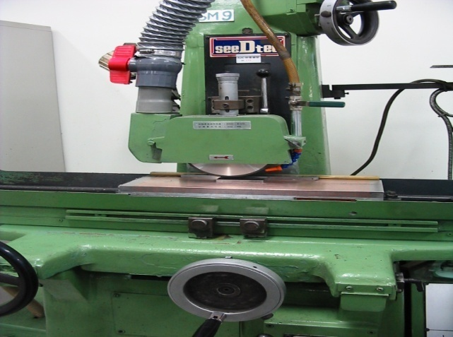
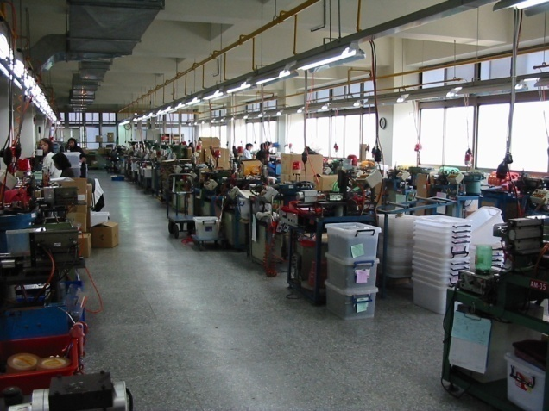
Production Line Overview

Slide 14
QC Organization Chart
QC Department
Quality Inspection
Document Control Center
Quality Control
IQC
IPQC
OQC

Slide 15
Customer Complaints Handling Procedure
Failure Analysis
Complaint Received
Standardize Corrective Action
Root Cause Analysis
Implement Corrective Action
Complaint Verified
Complaint and Corrective Action Documented
Corrective Action Approved
No
Failure Analysis
Yes
Execute Corrective Action
Customer Approval
No
Corrective Action Verified
No
Yes
Yes
Proceed to Customer Approval

Slide 16
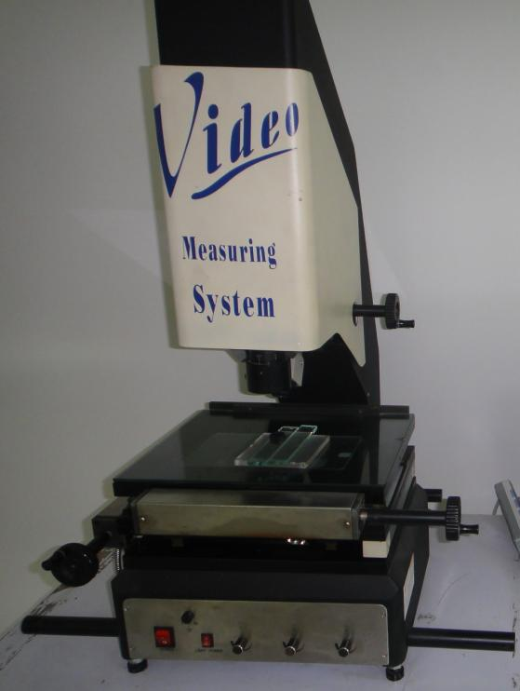
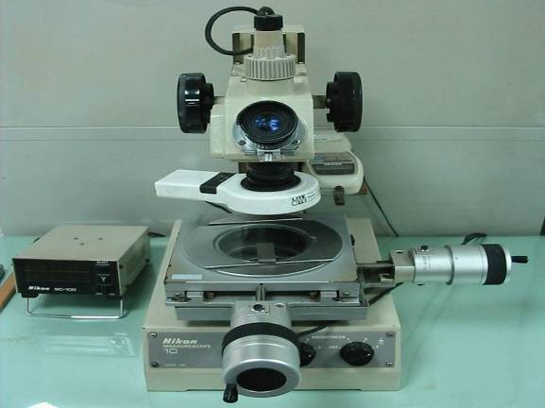
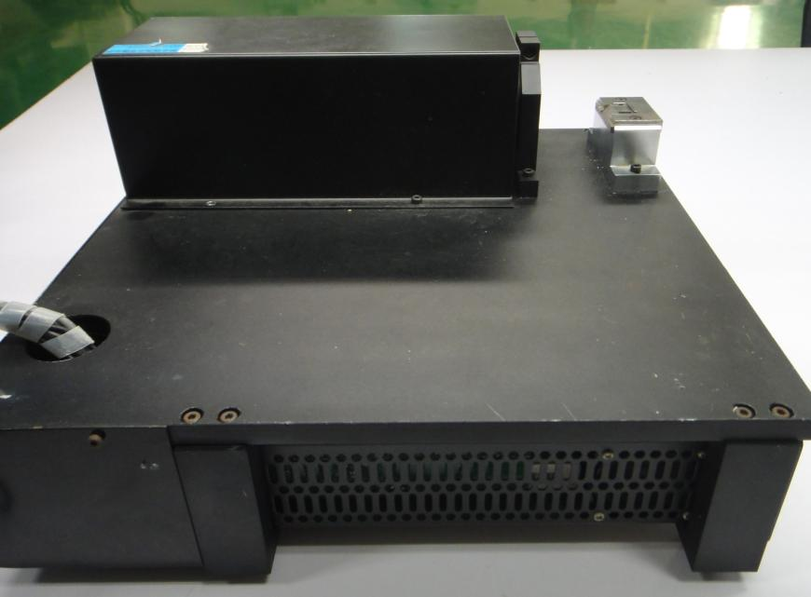
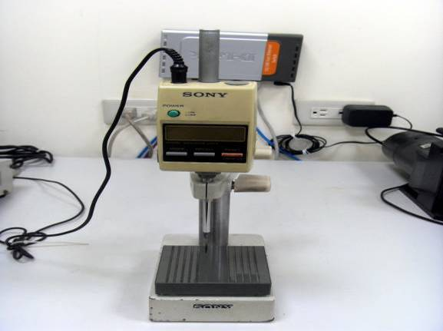
Dimension Measuring Equipments
Measuring Scope
CCD
Projection Scope
Gauge Stand

Slide 17
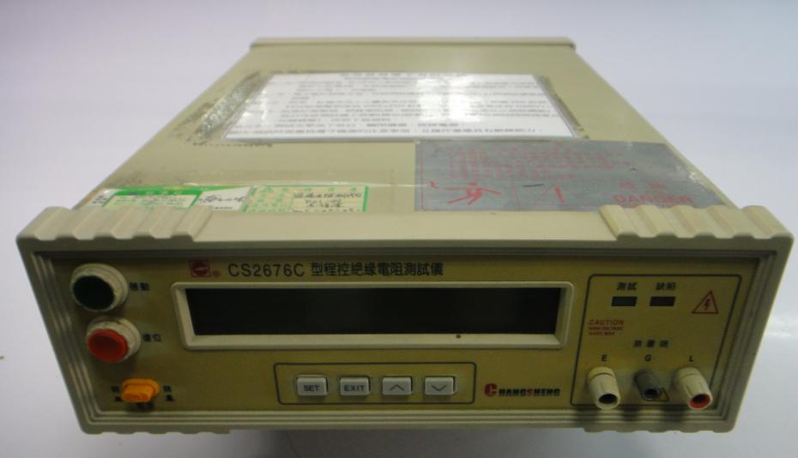
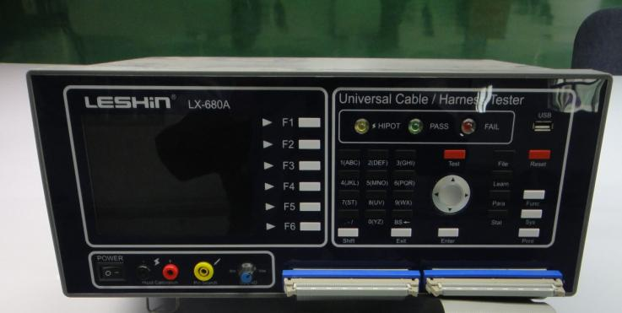
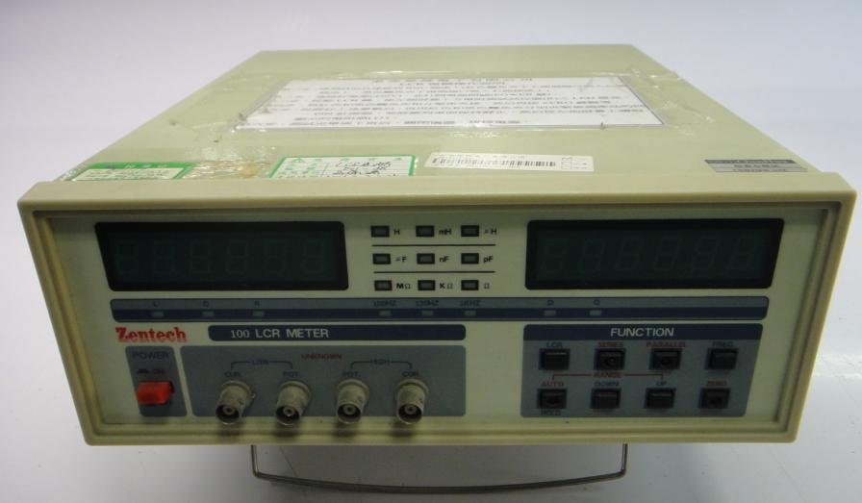
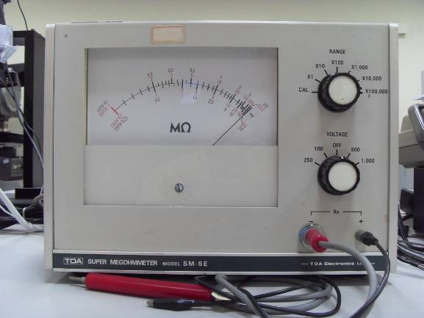
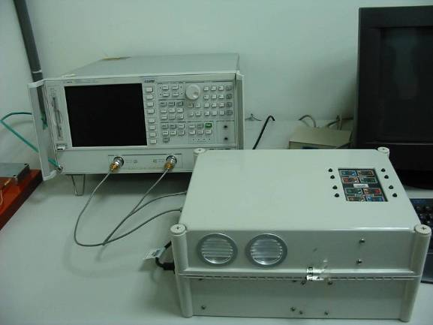
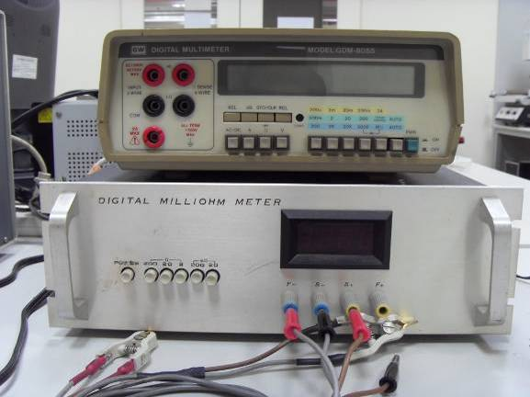
Electrical Testing Equipments
Insulation Resistance Tester
Cable Tester
LCR Meter
Connection Hardware Measuring System
Megohmmeter
Digital Milliohm Meter

Slide 18
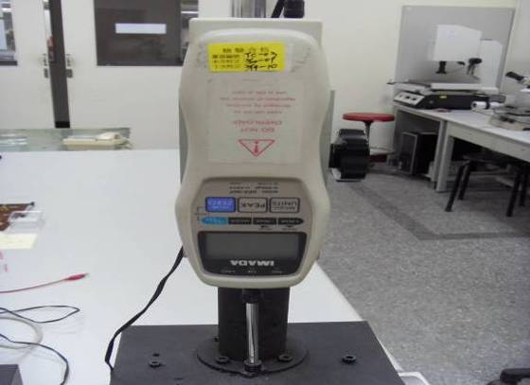
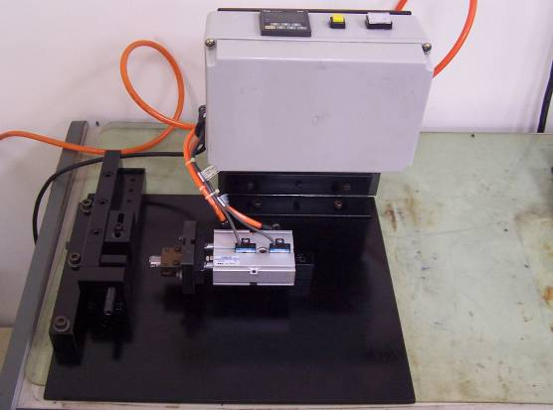
Mechanical Testing Equipments
Compression/Tensile Tester
Plug-in & Pull-out Tester

Slide 19





Environmental Testing Equipments
Salt Spray Tester
IR Reflow
Oven
Humidity & Temperature Chamber
Vibration Tester

Slide 20


Material Analysis Equipments
XRF (Plating Thickness)
XRF (RoHS)

Slide 21











Major Customers

Slide 22
End of Profile
THANK YOU!
Allen Creations Corp.
Address: No.36, Lane 243, Tzuen Shyan Street, Pei Tou, Taipei, Taiwan
TEL: 886-2-28203786
FAX: 886-2-28204169
Email: allenkj.yeh@msa.hinet.net
Website: www.allenkj.com.tw

